Slide 1

R-Project Predicting the average life expectancy of people of 193 Countries.
Submitted by: Rahul Sisodia

Slide 2

Aim of the project
Predicting the average life expectancy of people of 193 Countries.
We would predict the goal by Linear Regression machine learning algorithm

Slide 3
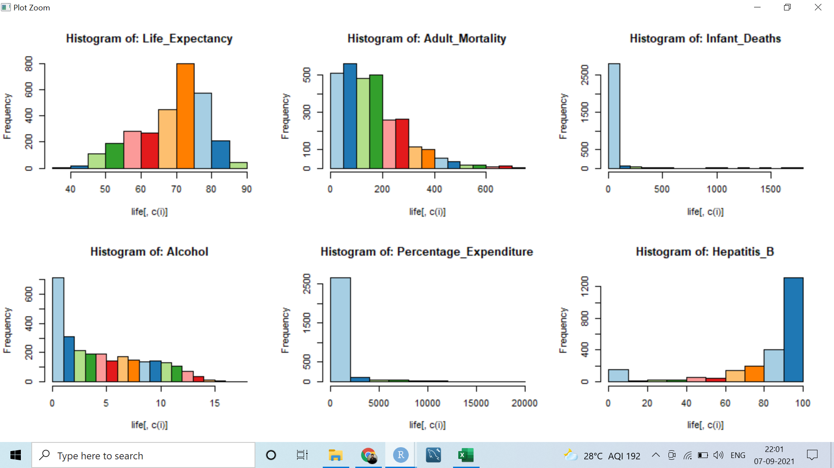
Univariate Analysis.
By looking at graph of Life Expectancy we could say it is almost normally distributed

Slide 4
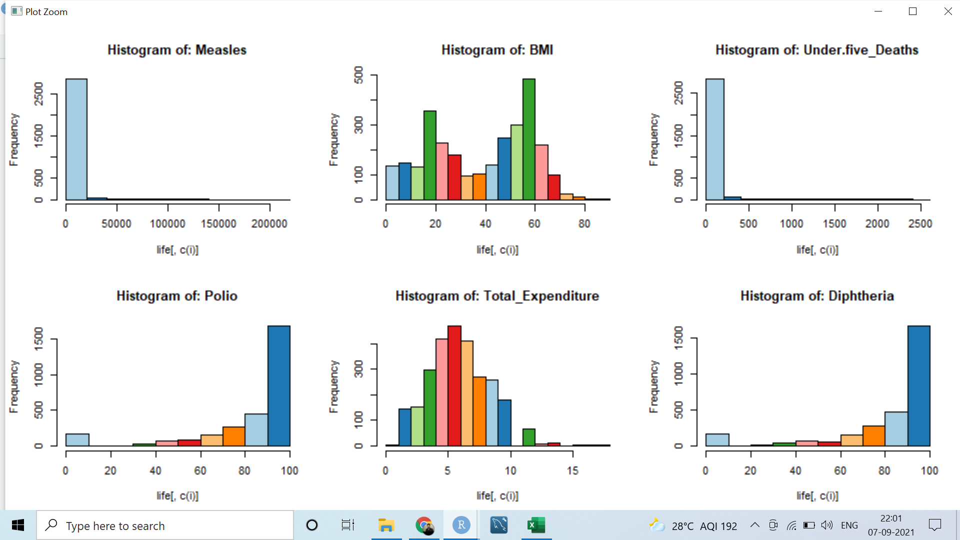
Univariate Analysis

Slide 5
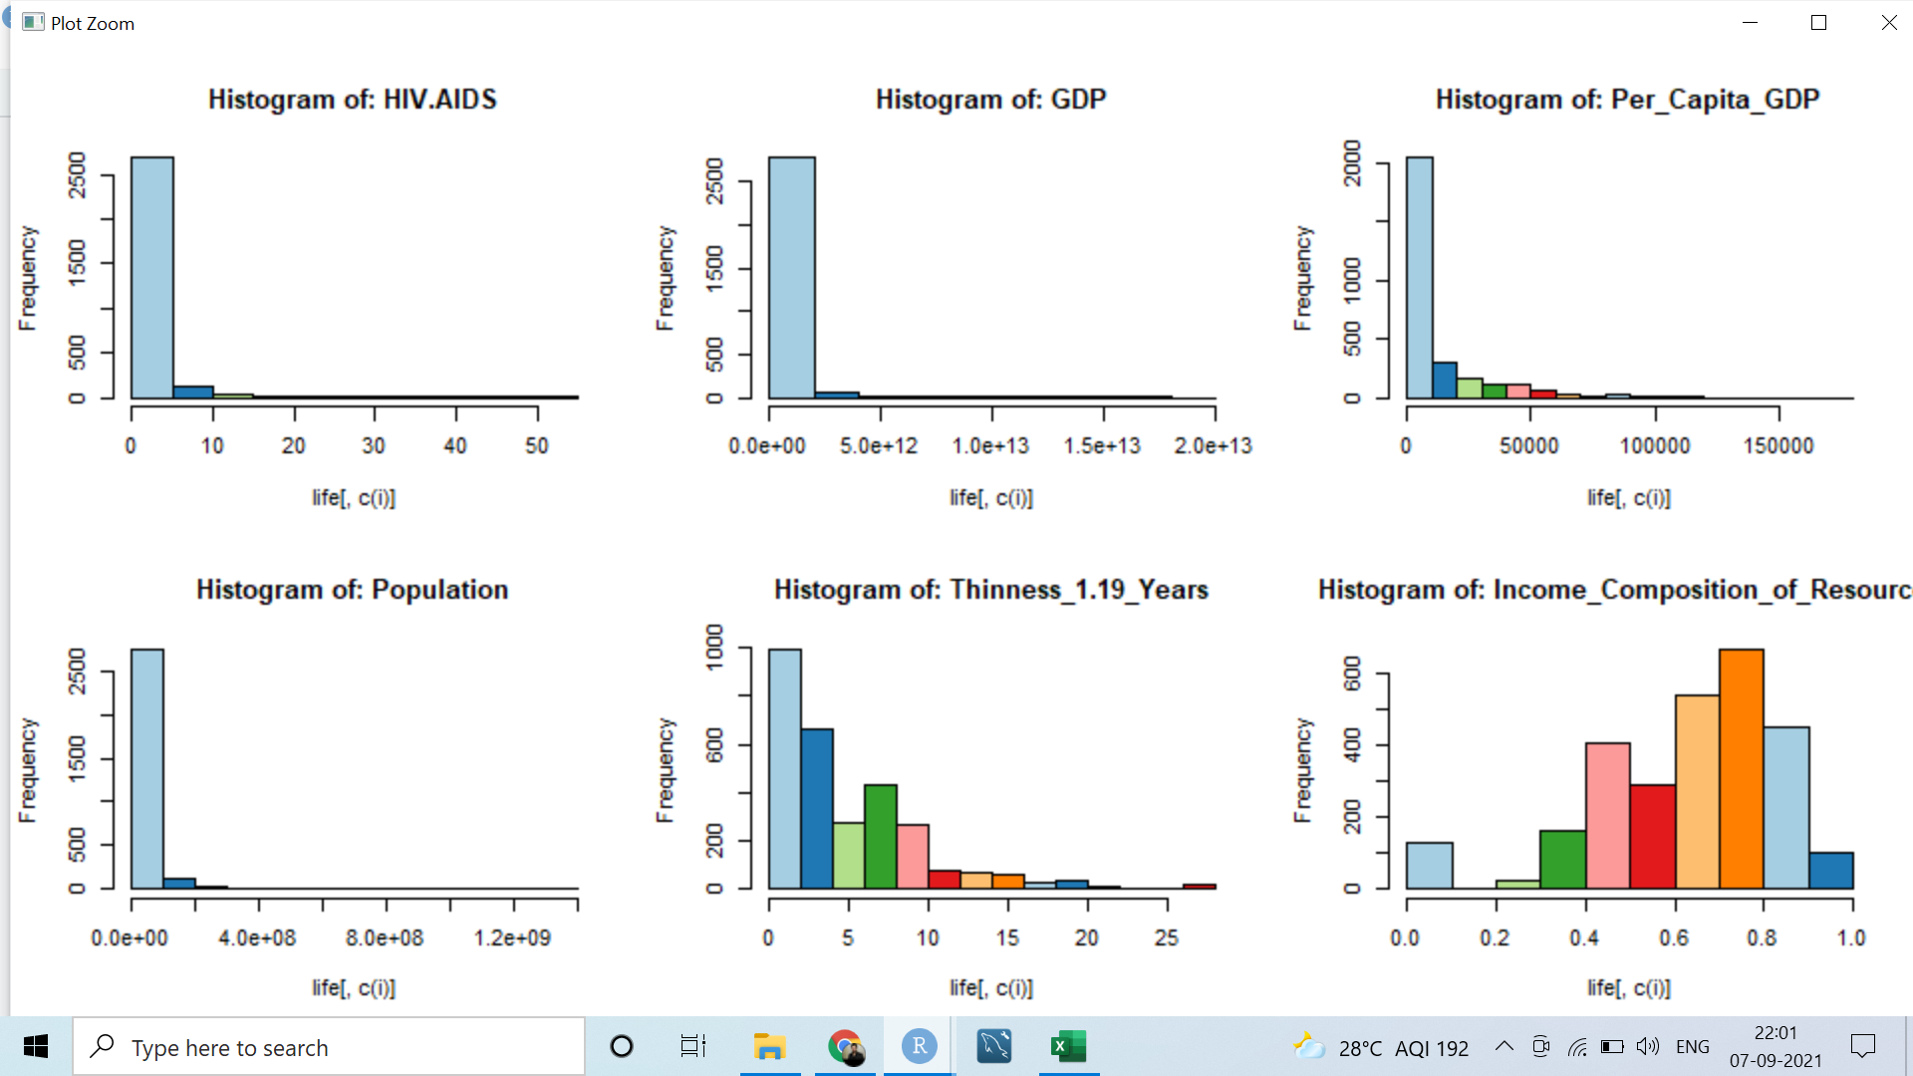
Univariate Analysis

Slide 6
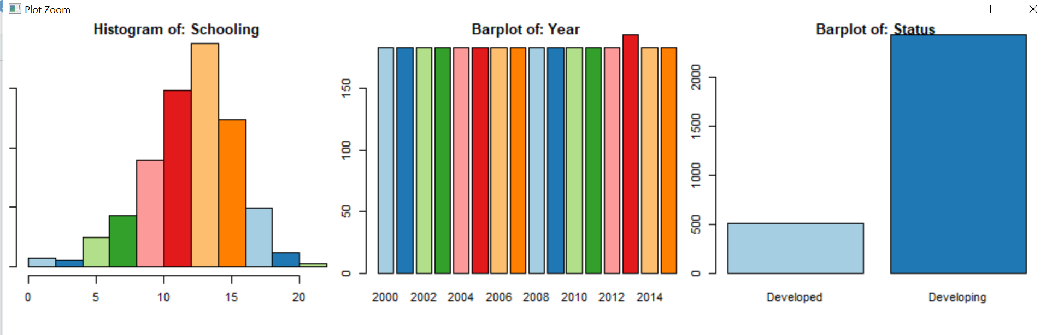
Univariate Analysis

Slide 7
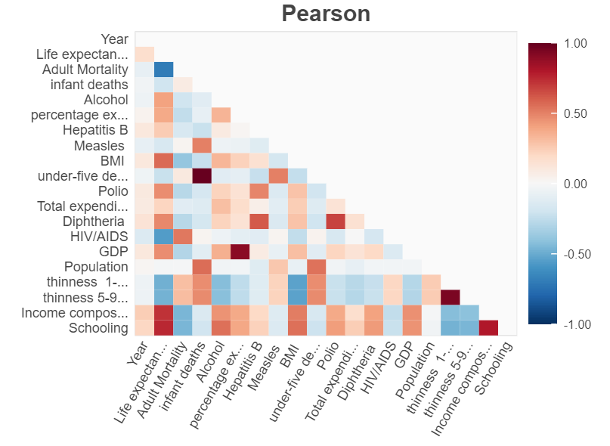
Correlation
Life expectancy schooling , Income composition are Highly + correlated
Life expectancy and Adult Mortality rate is highly Negative correlated
With respect to life expectancy polio, BMI, Diphtheria, GDP, Alcohol, percentage expenditure are also moderate correlated
Infant death and under five deaths are highly positive correlated to each other
Percentage expenditure and GD are highly correlated.
Thickness -1 and thickness 5 are highly correlated

Slide 8
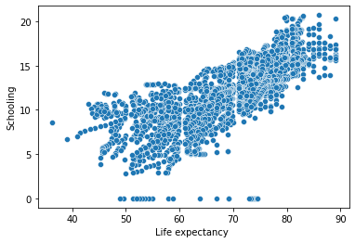
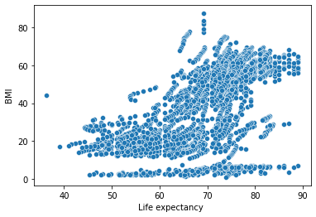
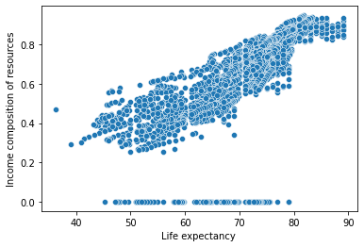
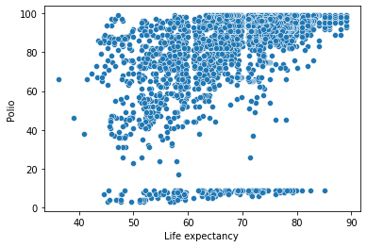
Bivariate Analysis

Slide 9
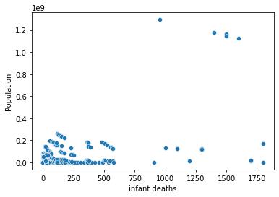
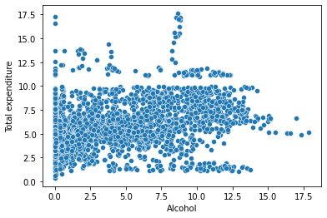
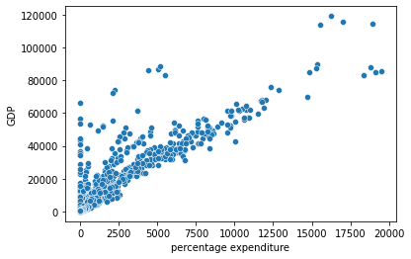
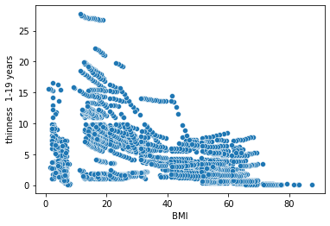
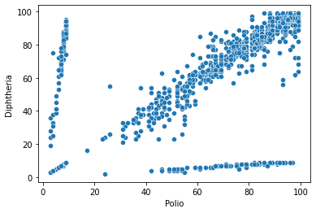
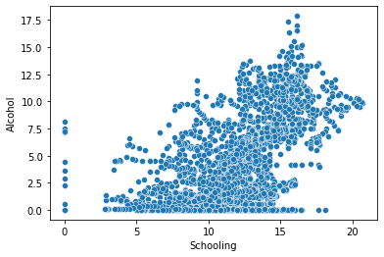
Bivariate Analysis

Slide 10
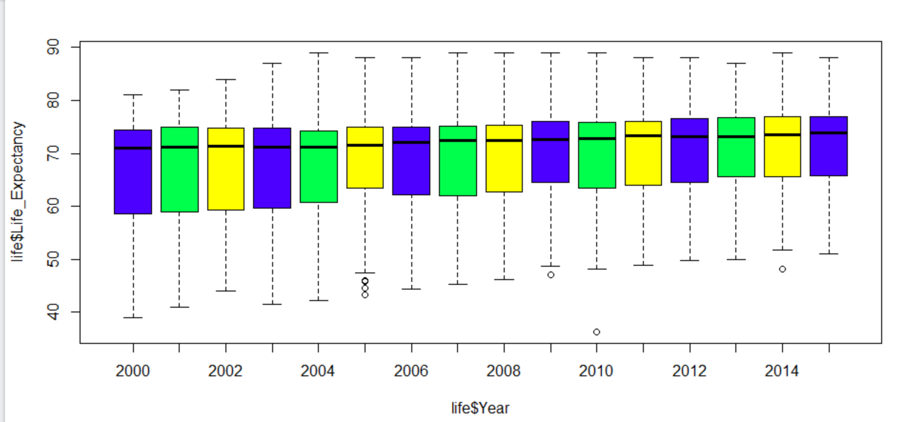
Bivariate Analysis

Slide 11
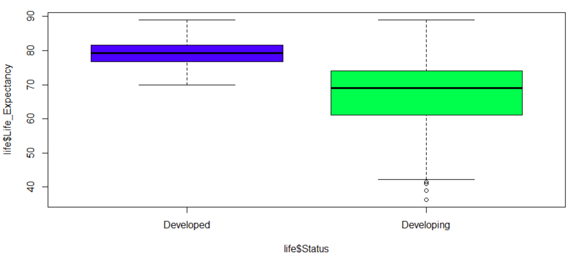
Bivariate analysis
Developed countries has much more life expectancy as compared to developing g countries

Slide 12
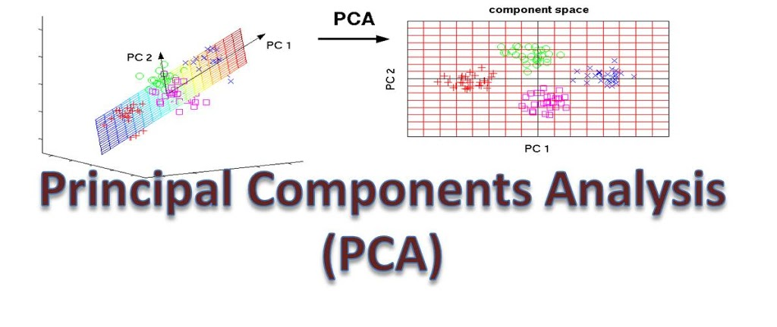
Principal Component Analysis
In our data set there are more feature. So PCA is used to overcome features redundancy in a data set.
These features are low dimensional in nature.
These components aim to capture as much information as possible with high explained variance.
PCA is applied on a data set with numeric variables.
PCA is a tool which helps to produce better visualizations of high dimensional data.
PCA is sensitive to the scale of the features.
PCA assumes a linear relationship between features

Slide 13
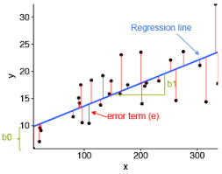
Regression Model
Linear regression model
Linear Regression establishes a relationship between dependent variable (Y) and one or more independent variables (X) using a best fit straight line (also known as regression line).
It is represented by an equation Y=a+b*X + e, where a is intercept, b is slope of the line and e is error term.
We build the linear regression model to predict the next year value of life expectancy.
Our model gives result Multiple R-squared 0.6332,Adjusted R-squared: 0.6329
p-value: < 2.2e-16

Slide 14
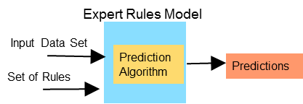
Prediction of model
Mean Accuracy of regression model is: 92.8165501692204
Median Accuracy of regression model is: 94.1660378564322

Slide 15

Thank you !

